Slide 1



sales dashboard powerbi
View in Power BI
Last data refresh:
9/15/2023 3:04:52 PM UTC
Downloaded at:
9/16/2023 1:43:12 PM UTC

Slide 2
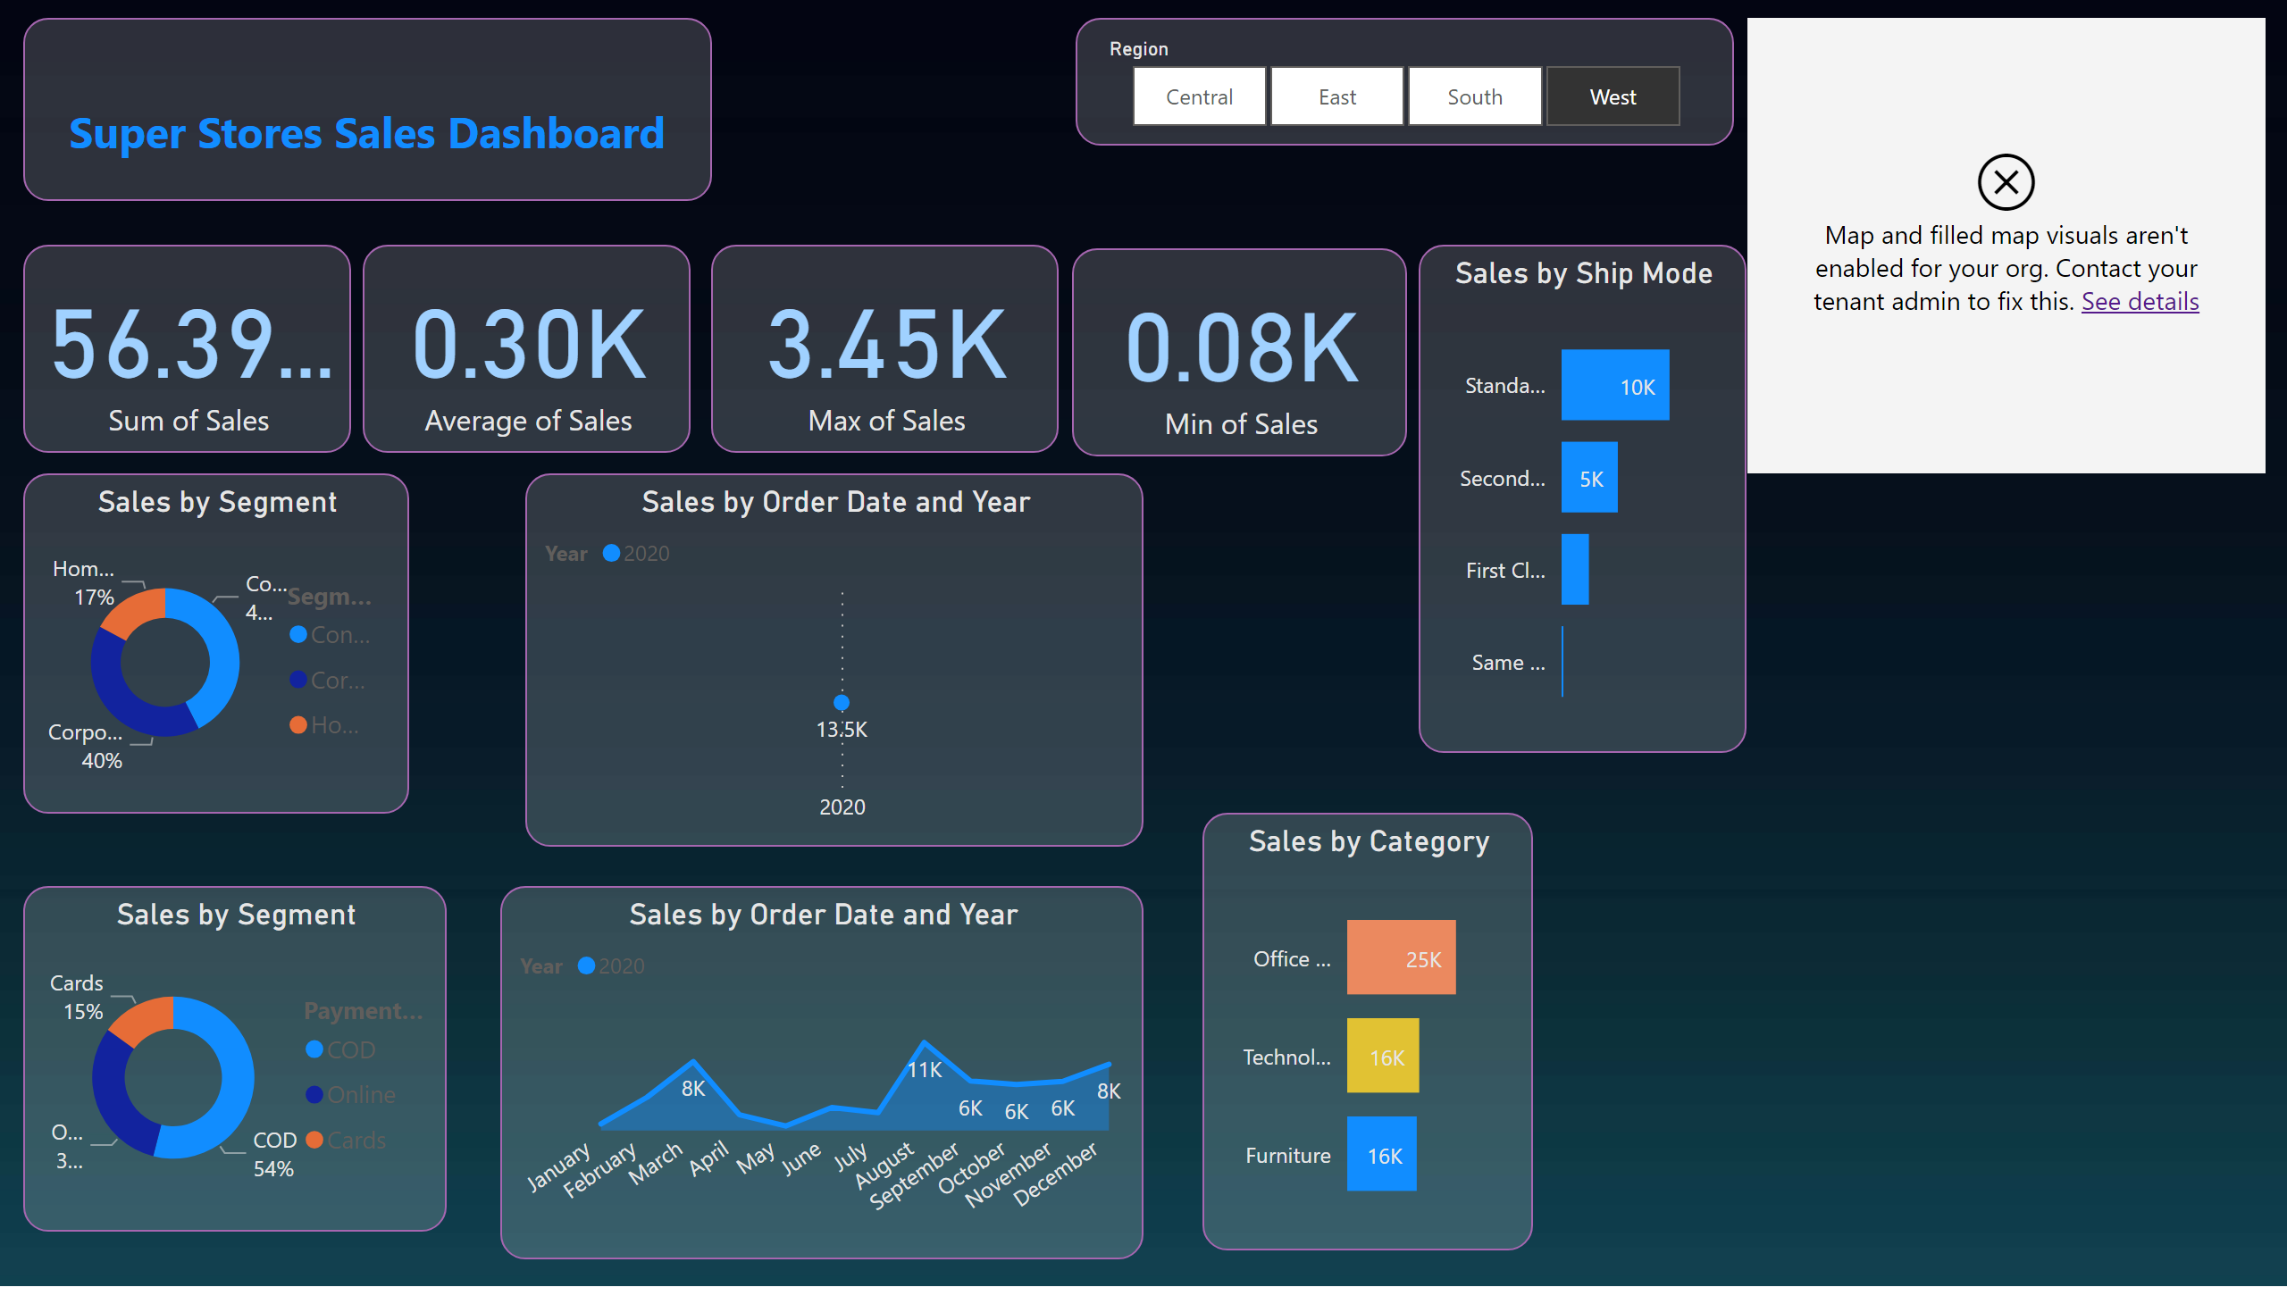
Dashboard
Notes:
Sales by Category
No alt text provided
Sales by Ship Mode
No alt text provided
Sales by Order Date and Year
No alt text provided
map
No alt text provided
Sales by Segment
No alt text provided
Sales by Segment
No alt text provided
slicer
No alt text provided
Sales by Order Date and Year
No alt text provided
textbox
No alt text provided
card
No alt text provided
card
No alt text provided
card
No alt text provided
card
No alt text provided

